Slide 1
Towards Analyses of Armed Conflicts in Ukraine and Georgia and appearance of the new Dividing Lines in Europe
(К анализу военной агрессии России в Грузии и Украине)
Tbilisi, 2018

Slide 2
OSCE Mission to Georgia/South Ossetia
(1993 - 94: mediation and project making for OSCE on conflict settlement in the region of S.Ossetia (ООН – в Абхазии, OSCE - .. «уши» везде… когда летали с дип/корпусом…
Attempts of inputting the OSCE principles of
II. Refraining from the threat or use of force III. Inviolability of frontiers IV. Territorial integrity of States V. Peaceful settlement of dispute… But all of them appeared abortive due to the so-called “Third party” efforts to keep on “frozen conflict” permanently..
-- Chairman-in-Office Madam Minister Margaretha af Ugglas visit to the conflict zone – прецедент…)
Визит одновременно в Тбилиси и (auto) Цхинвали (обед..)
встречи с руководителями…
OSCE Mission’s achievement – no “hot conflict” for the time of its work in the region…
But it happened in ‘08 in Georgia and in 2014 – in Ukraine…

Slide 3
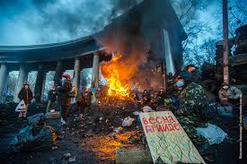
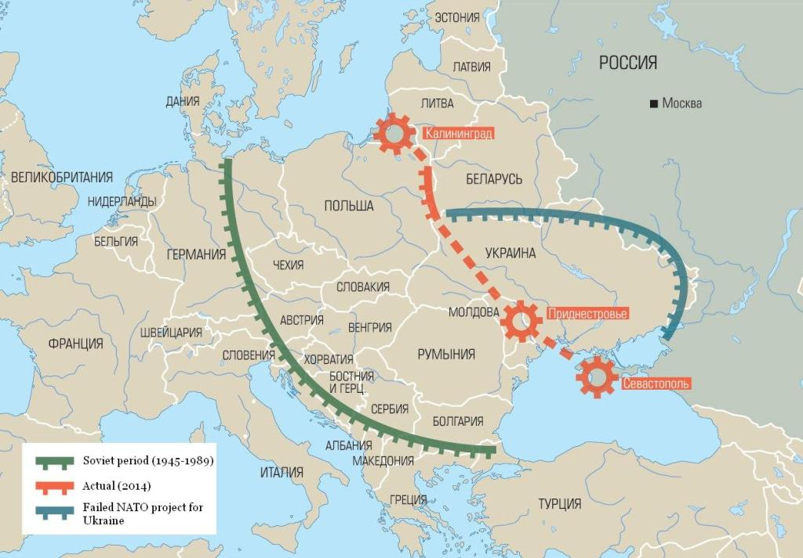
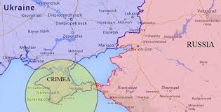
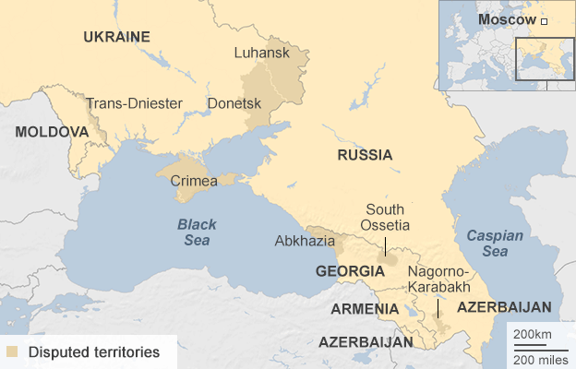
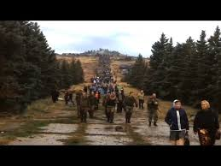
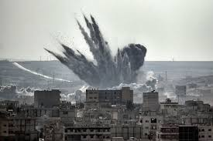
At the barricades we fought for our European future and values and don’t expect territorial agression…
But Russian goals and strategy were:
- «revival of the empire»… ( as we again -«теряем»..и нет буферa) + геополитика…
(если жить старыми мерками, то..)

Slide 4
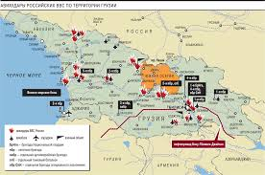
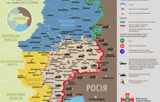
Russian goals and military actions in Georgia and Ukraine:
В Украине иначе - «имперский путь»:
22.02.14 спецоперация по эвакуации президента Украины В.Януковича (письмо-обращение…like insurance)
23.02 Putin ordered «to start the work on getting Crimea to Russia» - not just planning but start doing -
(27.02-28.03. - annexation of Crimea)
Further on – Donbas armed conflict – to keep situation hot - not solving it but prolonging, with small activity…
идея – не «замораживать», а «держать на крючке»…
+ demonstration of power, shale gas zones and oil wells on the shelf…=
In Georgia: Speedy achievements of strategic aims (full separation of Абх. и Ю.Ос., and due to this – stopping country’s movement towards NATO and fostering influence in Caucasus region…)
and that’s why – to frozen situation with separated areas…

Slide 5
Consequences for Ukraine:
4-years warlike conditions lead to unseen in the post world war period humanitarian outcomes (UN figures): 10225 dead, 24541 people injured both military personal and civilians. And each day those figures continue to grow!
Additional tragic facts: children in conflict zone,
1,7 million of IDPs and ruined infrastructure in the area.
Conflict situation threatens the very existence of the state…
At the same time it has facilitated unity of the nation and civil society: Hence, citizens believe that we should focus on three major priorities:
to achieve peace in Donbas and return Crimea;
to stimulate economy for getting better living standards;
to fight against corruption…/to achieve all these goals…
Interesting: main promoters of the reforms population believes upon - Government (20.8%), President (18.3%), volunteers (23%), Western countries (21%), population (19%)

Slide 6
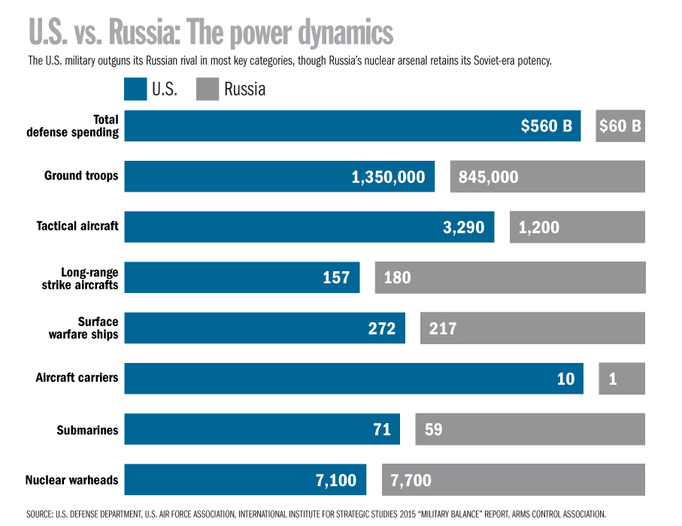
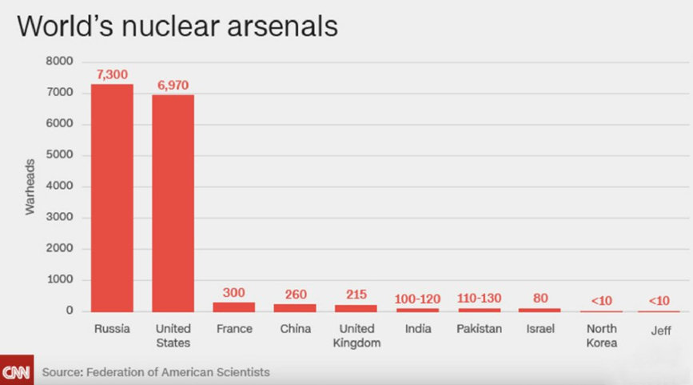
Strategic arms balance
Russia Is Not Happy About New American Anti-Missile System (300, 500-2500) Трамп – Корея, = пересмотр ПРО=
U.S. Missile Defense: Strategic GMD
and Progressive Aegis (500-1500: not Moscow)
(Iran 700;-1700)

Slide 7
To evaluations:
Russia – besides its geopolitical purposes - considers conflicts in Абхазии и Ю. Осетии as instruments of influence on internal situation in Georgia and in particular on her intention to join NATO. (In fact in August’08 – Rus. for the first time has used its armed forces beyond its borders and keeps them there as ultimatum…)
For the second time their “green little men” and special forces were used in March-April ‘14 in Crimea and Donbas against Ukraine
As a result/appeared:
Sharp increase of general tensions in the world… (НАТО – танки США Европе на уровне Хол/войны, ПРО, гонка вооружений… )
The issue of global trust in international institutions and International Law…
Would be a mistake to consider conflicts in Georgia and Ukraine separately (after all, the RusFederation has plans for the restoration of the empire)

Slide 8
ergo:
new routes needed to integration with Europe and NATO" (as it is easier for Russia to destabilize individual countries alone)
MAP (Membership Action Plan) facilitation for both countries – could be one of them and most promising…
Already our interuniversity and in general interpublic communications could effect peacebuilding opportunities and assist in breaking through - towards joint European prospects…
= it is necessary to keep on joint international sanctions against aggression ... If we wish to protect our goals and rights…
=and another issue of rising of civil society ... (the adoption of European values, education, SME development, middle class growth...)
theoretically positive changes could happen in Russia in future
(So, for all these purposes we should work and cooperate together...)

